Slide 1
Today
Assignment stuff:
Ask up front if you have anything quick.
If there’s something you want to dig into more, please ask at the end.
Today’s excitement!!!!
Ipwidgets for basic interactivity/GUI.
Callbacks, registration, listening functions. (This is an important concept in the future).
The UI stuff is not something you’re evaluated on, its mainly an exercise in tackling new libraries and adapting our code to the library. That’s needed.
In future data exploration stuff, you could use some of this to make your lives easier/better as a UI might help. It might be useful on the first ML assignment, though it isn’t mandatory.

Slide 2
Mo’ Housekeeping
Lab 6:
There’s a file posted on brighspace that has the starting point and questions.
GitHub is giving me some error when I try to make an assignment, like it is broken, I will post that once it’s fixed, and you can just copy/paste your file into it.
There’s no testing because of this, just do the file’s directions, there’s nothing automated.
Project and practice work:
Dong and I talked yesterday and figured out (broadly) what you guys will do for project work next semester – we can get real estate data in YEG, so you’ll be doing some modelling there.
For practice in pipelines and stuff we can work in some geospatial data.
Ideally, you can start exploring the RE data early in next semester.

Slide 3
UI and Widgets

Slide 4
Interacting with Programs
Right now our programs have very little interactivity.
Mostly run from top to bottom.
We can add things like input() to get some data.
Most programs don’t work like this, they have an interface.
Text interfaces generally suck for most people.
We can (relatively) easily add some interactive bits to our ‘normal’ code.
Replace the function calls for each action with button pushes (or other).
Replace the data that is shown from a print to sending it somewhere (text box).
Functions each have a start/end, we are just redirecting each to a GUI instead of command.

Slide 5
Graphical User Interfaces (GUI)
A GUI is how we interact with most programs as a user.
I.e. we click buttons and type values in some type of window, not a command line.
To create a user interface we use some library that provides most of it.
The library has UI elements – buttons, text boxes, menus… that we can use and customize.
We don’t need to do the hard work, just connect the UI to our code.
There are lots of UI libraries.
We’ll use ipwidgets, which provides some webpage-like interactivity.
Other libraries like tkiner or pyqt provide a similar basis on which to build ‘real’ apps.
The code isn’t overly complex, but it does change somewhat…

Slide 6
Using GUI Frameworks (Side Note)
In general, these types of libraries can be large and complex.
Ipwidgets is a simple one, that we can use for basic things.
For ds applications we might use something like plotly or streamlit for a UI.
Using one of these things involves effort to learn the specific tool.
We’d need to spend some time getting up to speed on the library itself to be ‘good’.
Web developers use something like react or angular.
Similarly, in ML, we’ll use:
Sklearn (pretty universal).
Tensorflow (one of two big NN libraries, with PyTorch)
In dweeb speak, we call the technologies we work on our ‘tech stack’.

Slide 7
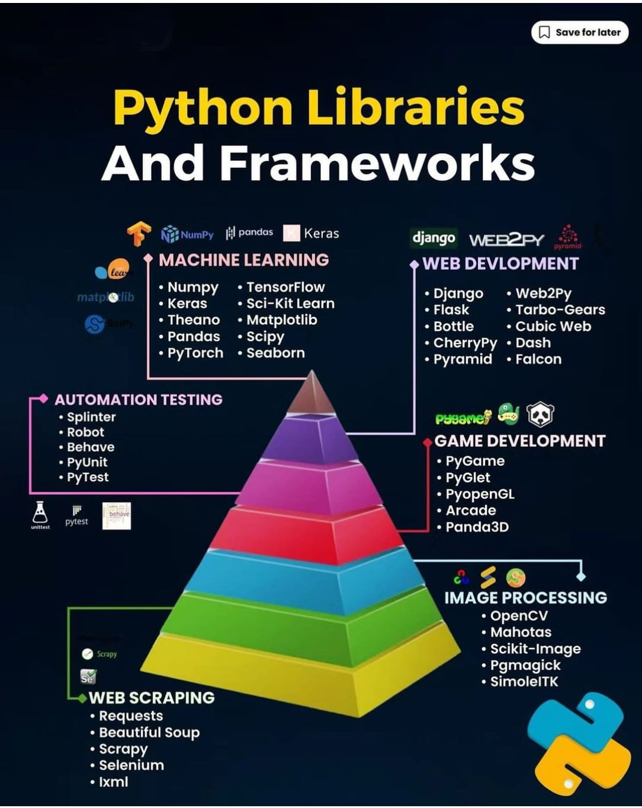

Slide 8
Learning The Stack
These large libraries are common, and in most domains you’ll learn a few.
It’s kind of like learning to speak Newfie or Australian if you speak English.
These libraries serve to remove the majority of the ‘infrastructure’ so we can focus:
Thinks like “what’s a button” or “how do I capture a click” are abstracted away.
We don’t need to know how to draw anything, we can ”speak API” to the library.
We can use GUI frameworks to only specify what we want, where, and the action attached.
The execution and the UI are not interdependent on each other.
The frameworks provide an easy interface and handles complex details internally.
Drawing lines, registering a click, measuring mouse position, etc… are always the same.
We don’t want to learn to do that, we want the higher-level goodness!

Slide 9
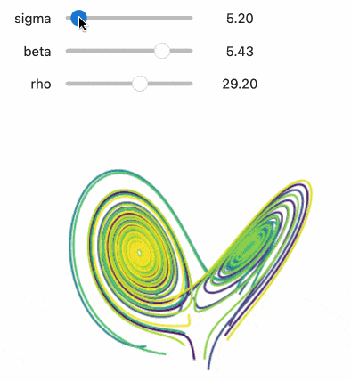
IPYWidgets
We’ll use a library called ipywidgets to make a simple GUI.
It is relatively basic and provides elements like we’d see on a website.
We can make widgets, tie them to actions and data:
As long as our logic works, the actions should trigger them.
The ipywidgets handles the details – how do we read the value from a slider, what do we do when it updates, etc….
Near 0 of the “how does a GUI work” part is left to us.
We define a ipywidgets GUI that has these elements.
We only need to provide logic for our app, not the GUI part.

Slide 10
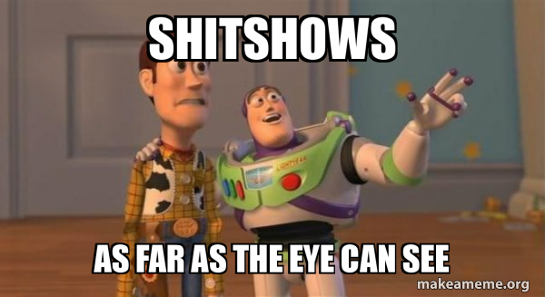
Parts of the UI
Widgets, so many widgets…

Slide 11
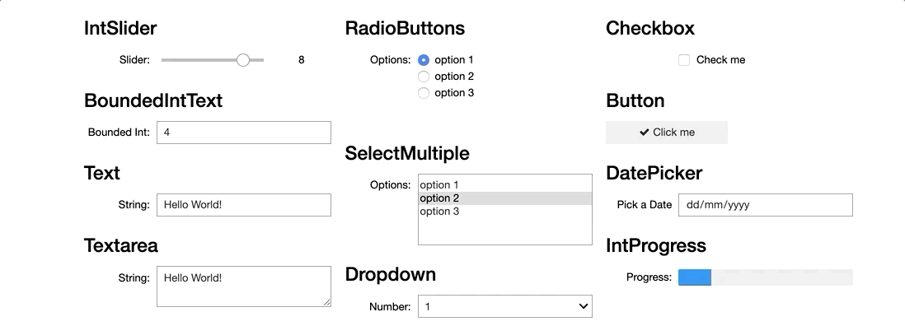
Widget Options
For the most part, we can make widgets that correspond to what we’d have on a website.
There are a large number of these widgets, we’ll only focus on a few.
There are a few broad classes – buttons/boxes/sliders, text boxes, and layout items.

Slide 12
UI Widgets
Each widget, or UI element, has properties and our code responds to them.
When a button is pushed, a value is changed, or a box is checked, we do something in response.
We normally just “sit” or endlessly loop waiting for something to happen.
Later, in the machine learning stuff, we’ll use this concept more:
We have long loops to train models.
We can register callbacks to do certain actions during that process, like write a log, save a copy, or stop if the results are good enough.
So a GUI based app is largely a big loop (or ‘wait’), with a function for each element calling action.

Slide 13
Separating Parts of a Program
As we make our program, we can keep two parts separate.
Logic – we had a working poker game that has functionality, but using it is weird and annoying.
UI – we can make an interface to allow the interaction with the logic (i.e. call functions).
Those two things are separate, and independent.
We could make another UI that calls the same functions, either will work.
We can always swap out one UI for another, the logic of the code stays.
This is why things can work semi-seamlessly on an app, website, mobile website, etc…
We can have the data and functions in a website stored. The UI elements grab parts as needed, but each can work with the same data, just displaying it differently once grabbed.

Slide 14
Using Widgets
Our widget-based UI isn’t a full GUI, it is more like a webpage.
We can embed any of the widgets in our notebook’s display.
We can weave those widgets in with our needs, for example:
Exploring correlations – choose x and y for a scatter plot.
Checking distributions – swap between values for a histogram.
Looking at many features – use tabs to change what we see on the fly.
Performing multiple trials – use input widgets to get settings/config without changing code.
In our “backend” code – we may want to make a function per action, then deal with changes there.

Slide 15
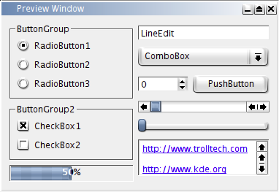
Actions
When using a GUI the execution of code tends to be based on user actions like clicks and button presses.
In “backend” code (no UI) things just run.
We need to build things to respond to action, not run in sequence.
This is done through the idea of a callback.
Define an action that will happen in a function.
Attach that function to a UI element.
The library ties those two together, so the function is called.
Our code is built to respond to UI element changes.

Slide 16
Callbacks
Callbacks are an important and frequently used concept.
When this thing happens (click, error, upload, new round, scroll), do this other thing (some function).
The callback function is set to automatically trigger and do the needed.
Here, we have an action ready to go for each UI element.
Those action (or the code for them) is ‘registered’ or attached to some event trigger (e.g. button)
Separation of UI and logic – the logic is in the same function, the UI triggers it, the library manages that.
If our original code is well encapsulated, this can be relatively easy.
This may trigger refactoring, or rewriting working code to be better organized. E.g. func does 2 things.
In machine learning, we’ll use them for logging and monitoring.
Every time one round of training progresses, do some actions.

Slide 17
Gui Based Programs
GUI based programs are normally always waiting to do something.
Each action calls back to some function, this does stuff – run calculations, update values, save data, whatever….
The functions that are callbacks will execute in ‘rounds’:
Whatever function gets triggered will run, when done it’ll return/update.
Once complete, we are back to waiting.
Functions should either complete a process, or call others to complete it:
Generally easier to make callback function = 1 real action action. (deal, find winner, add bank)
We don’t want to or can’t rely on other things – that function call does it all.

Slide 18
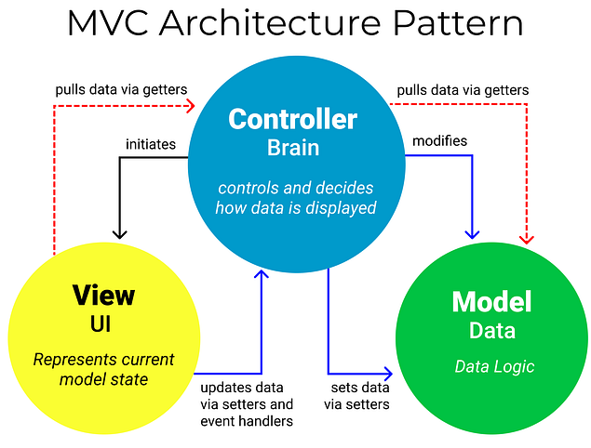
MVC to the GUI
The MVC concept we saw in OOP works with this.
The view (GUI) gets data to show and sends input.
The controller (obj.) does the ‘work’
The changes in data are updated in the data store*.
For us, we just have an object to hold data.
In other cases this might be db/disk. E.g. we are xforming data, then it is saved to disk. C ‘working’ data may be temp.
View can’t impact data directly.
I use an analog of a turn based game….

Slide 19
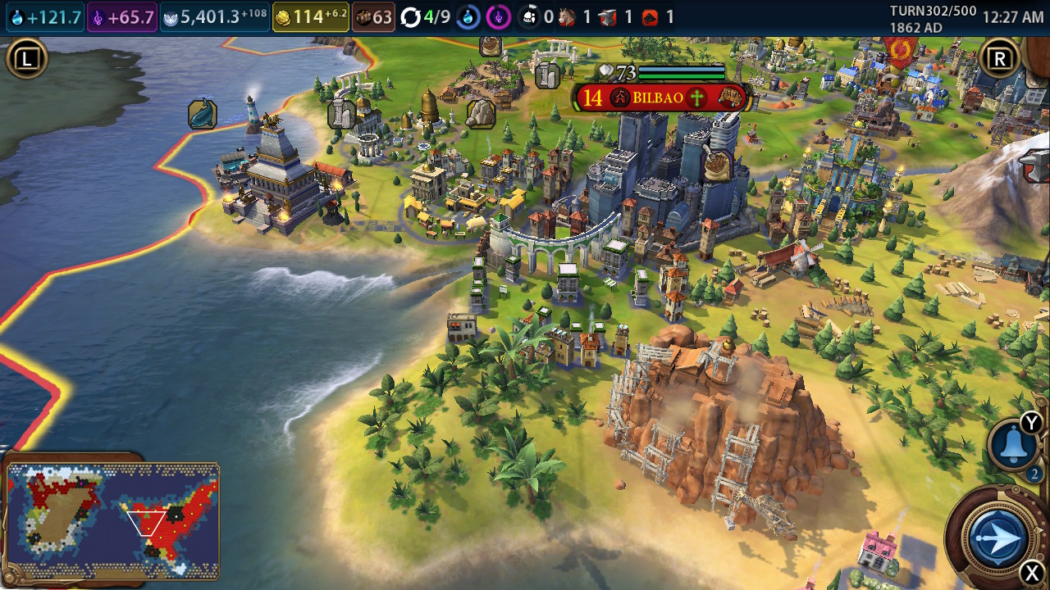
Turn based Programming
I think a turn based game is a good mental model.
I’m no gamer, but like Civilization.
Model – the ‘stats’ – what you own, money, area on map…
View – what you see. This is updated after each turn.
Controller – the logic of the game, battles, production, etc…
If you’re nerdier, it is also similar to a DB controlling updates.
Each turn we provide inputs (V), they process (C), then are saved (M) and we can repeat the process.
I can’t use the view to “take” a square, I have to ask the controller, then it will check (e.g. battle, price) if I can.

Slide 20
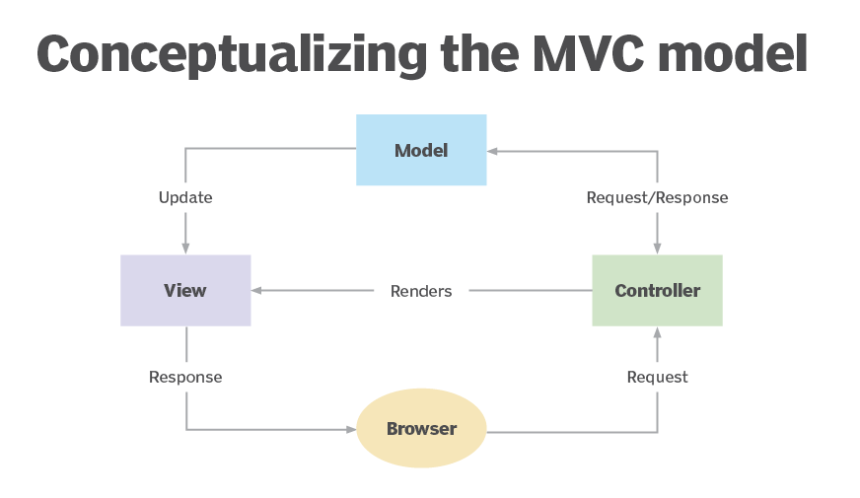

Slide 21
Building, One Widget at a time
For each widget, we generally need to define:
Is there an action attached to it? If so, we need a callback to call it.
Is there data ‘on’ (label/value/text entry) it? If so, where are we getting that?
Where does it go? We have grids and tables and other things to make a custom layout.
Creating a GUI application is a pretty simple thing conceptually:
For each thing that needs to happen, attach that to what triggers it, like a button.
For each thing that needs to be shown, attach that to some widget, like a text box.
Once we have each thing we need attached to its UI counterpart, we’re mostly done.
It may be easy to miss things, especially initialization of wrap stuff. (e.g new game).
May need to reset stuff, as the GUI tends to stay active, while Run All is a new go…

Slide 22
GUI wrap
This stuff isn’t of critical importance to us, but it is of interest.
If we ever need to change a variable or configure something, simple widgets can help.
We commonly change and rerun stuff when exploring data.
If we need to present results, this is helpful.
Organize output, allow for customization, and incorporate parameters.
The callback concept is important.
This is good practice for translating from documentation without it being critical.
Separate logic from UI – dealing a hand is an action, it can be triggered by a button, box, message, etc… The idea of what is happening remains, the tool to do it changes. Data/inputs can come from a text line, input box, text field, database lookup, etc…

Slide 23
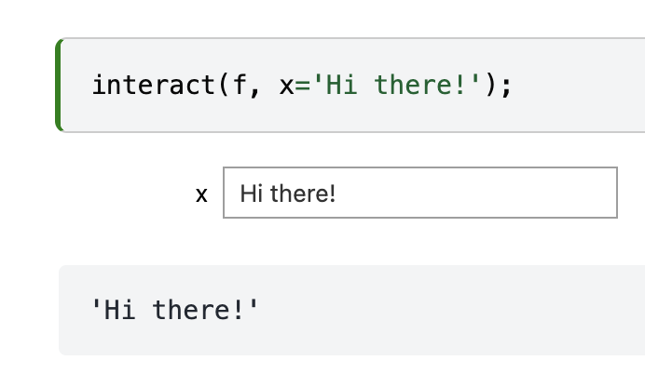
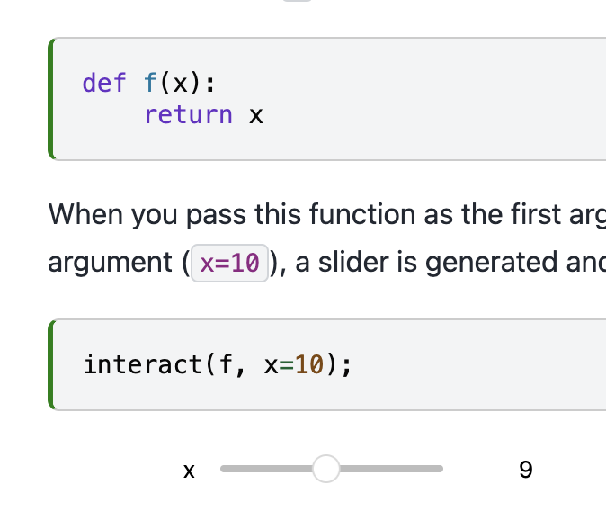
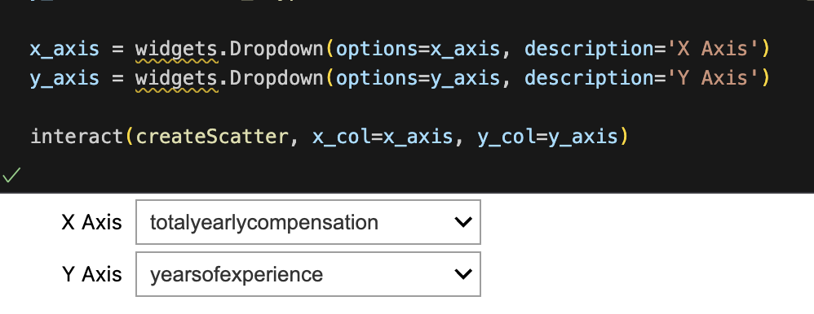
UI Elements We’ll Make
Our use of the UI will be simple.
We create widgets and attach them to functions.

Slide 24
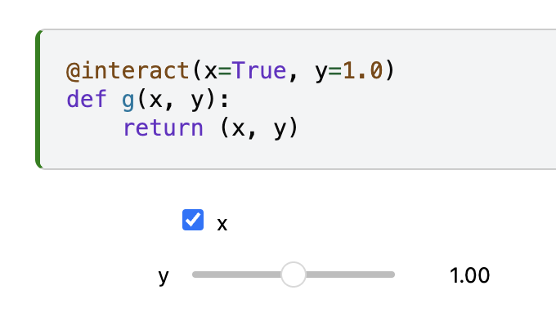
What About us?
We will use one part of the ipyw library – interact.
https://ipywidgets.readthedocs.io/en/8.1.5/examples/Using%20Interact.html
Interact (roughly) ties the action and the ui item together when making widgets.
This is the simplest way, and the most like “make this button do this”.
There are some defaults that are built in, which are usually good. (E.g. type of control)
If you want more control, you can use the other parts and get fine grail control.
We can also use our friend the decorator to wrap the UI around a function.
There’s also interactive – which is similar, but returns instead of draws.
Similar to how str or some plotting funcs can return an object, rather than showing it.

